Slide 1



Building Trust through (budget) transparency
Thomas Prorok

Slide 2
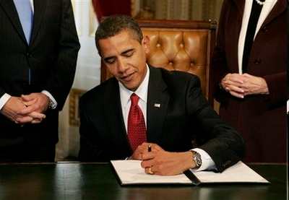
Tranzparenz und Verantwortung
„The way to make government responsible is to hold it accountable. And the way to make government accountable is to make it transparent so that the American people can know exactly what decisions are being made, how they‘re being made, and whether their interests are being well served“
Barack Obama, 2009
AP Photo/Molly Riley, Pool, http://www.flickr.com/photos/ocean_of_stars/3213219423/
Notes:
Wer hätte gedacht, dass sein Verständnis von Transparenz so umfassend ist, dass es auch den Email und Telefonverkehr der Weltbürger miteinbezieht.
„Hat NSA Open Governmen zu ernst genommen“
Vorsicht geboten, dass Transparenz die gläserne Verwaltung und gl Staat braucht und nicht den gläsernen Bürger.

Slide 3
Open State – Open Government
Regulatory
State
Citizen State
Open State
Service State
Objective | State of law | competitiveness | social cohesion, quality of life, participation | Transparency, participation Co production
focus | state/ souvereign function | Market, customer | Citizens, communities | Society and civil society organisations
argumentation | legal | economical | politics | values
governance | Hierarchical | market | networks | Co-Production / Open Innovation
modell | bureaucracy | New Public Management | Public Governance | Open Government
origin | 1921 (Max Weber) | 1980ies 1993 Neues Steuerungsmodell | End of 90ies | 2010+
Quelle: Banner, Bovaird, Löffler (Governance International), modifiziert Prorok, Krabina (KDZ) 2012

Slide 4
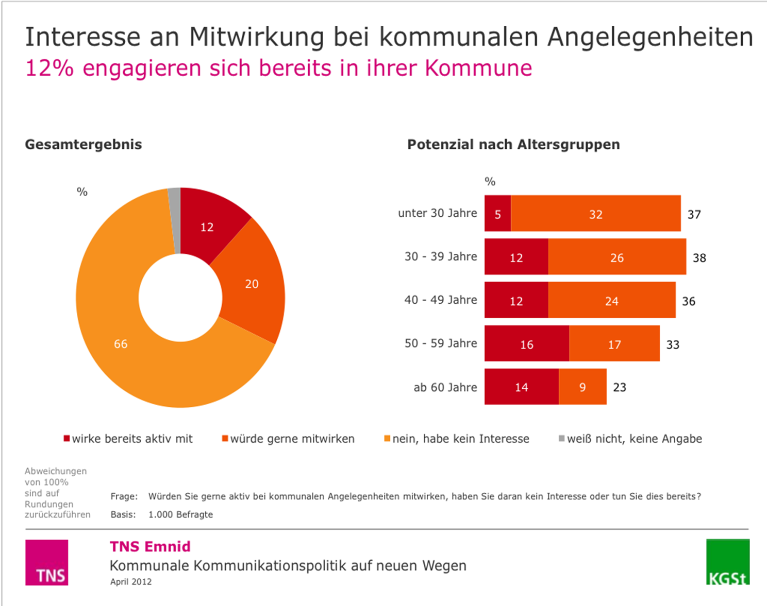
Thesis 1: Citizens want to participate
Study in Germany on local level showed:
12 % are engaged in local community
20 % are interested to participate
38 % of citizens aged 30 to 39 are engaged or want to participate

Slide 5
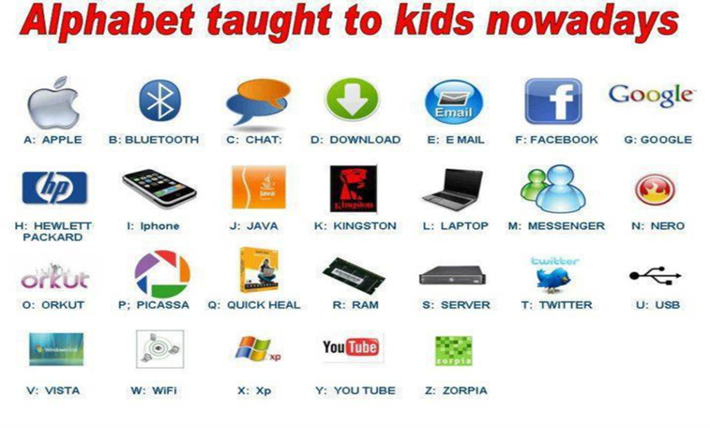
Thesis 2: Social Media are catalyst for participation
Social media change communication of politics and administration fundamentally
New forms of political participation
Variety of information gathering for broad
Involving new groups of citizens
Make decision making processes transparent & comprehensible
Potential to influence public debate
Zweiter Zwischenbericht der Enquete-Kommission „Internet und digitale Gesellschaft – Medienkompetenz“, Deutscher Bundestag, Drucksache 17/7286, 21.10.2011, S. 10

Slide 6
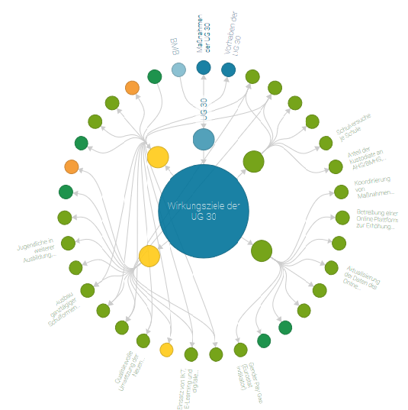
Thesis 3: Transparency is the basis for participation & trust
Transparency enables
Citizens & civil society receive information
Creation of awareness
Impact monitoring of government
  Increase in the educational level of the
  Pupils and target groups in adult education
  Improving opportunity and gender equality in education
  Increase the effectiveness and efficiency of educational administration
www.wirkungsmonitoring.gv.at

Slide 7
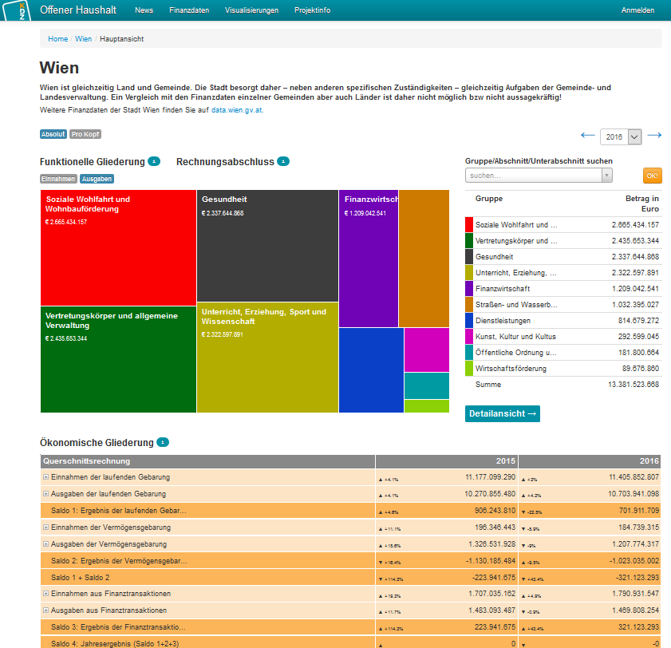
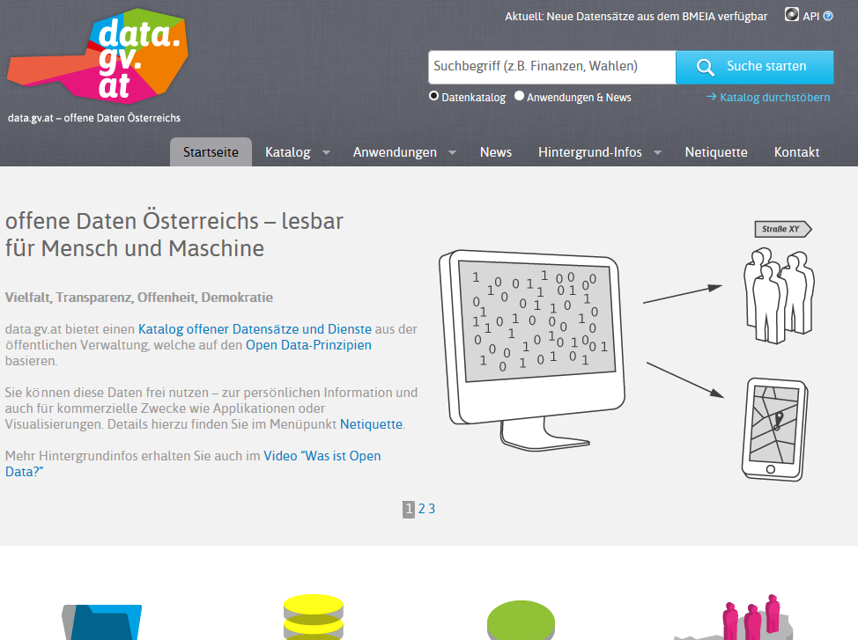
Thesis 4: Open Government Data is ONE IMPORTANT part of transparency & participation
„Data is the new gold“
(Neelie Kroes)
Involvement of „Community“
Data need explanation/visualisation
www.offenerhaushalt.at

Slide 8
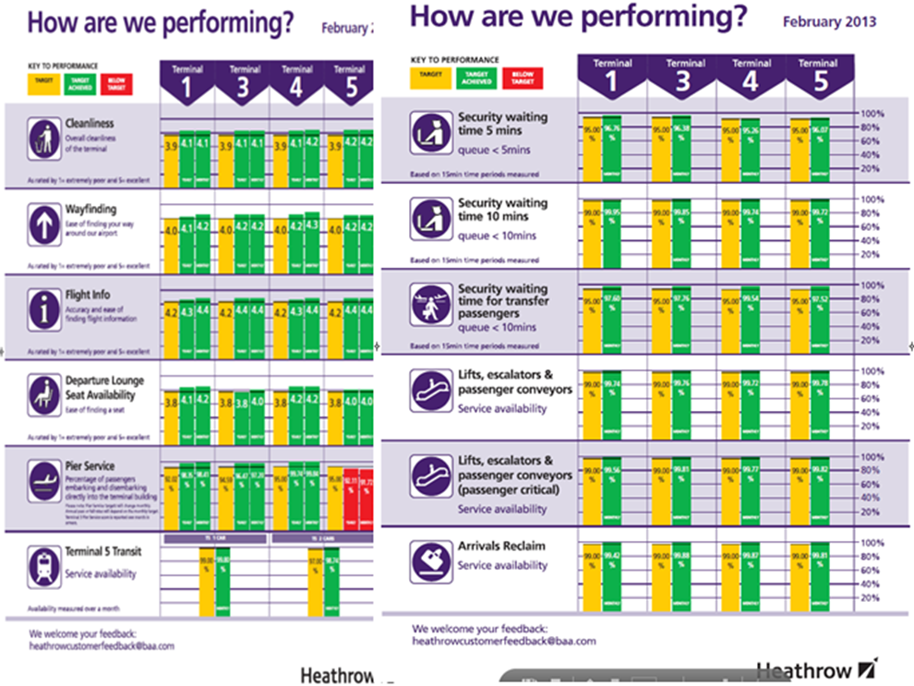
Thesis 5: Citizen Services & quality management are important drivers for participation
Good citizen service always involves citizens and cso
Quality managagement focuses on expectations and needs of citizens and customers
  Surveys
  Questionnaire
  Citizen meetings
  Complainment systems
Learning Participation

Slide 9
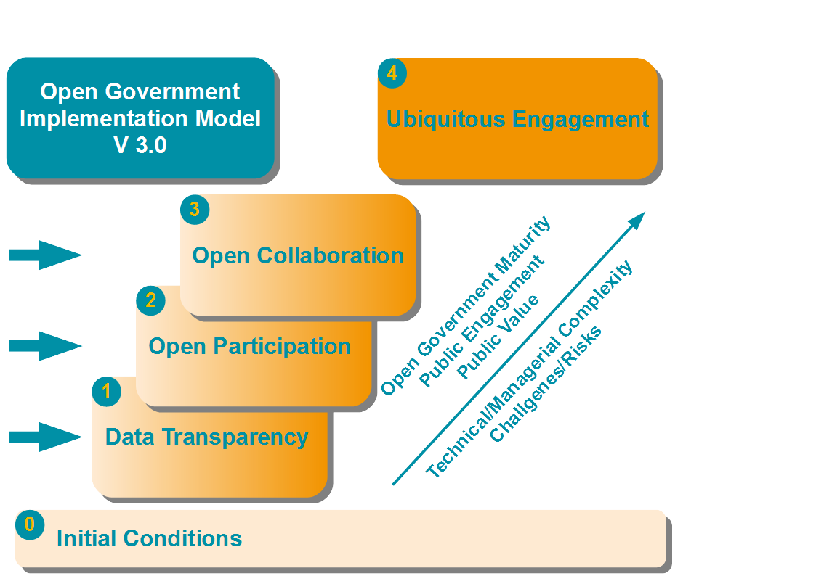

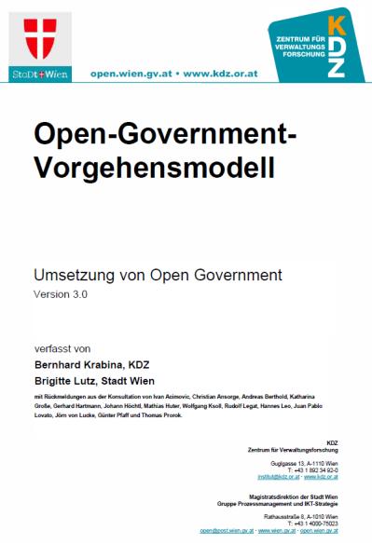
➔With the Open Government to a culture of open participation
http://www.kdz.eu/en/open-government-implementation-model

Slide 10
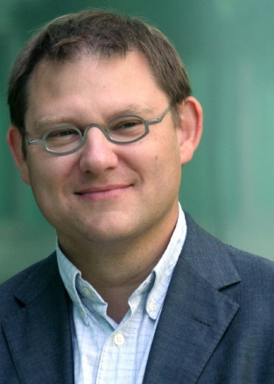

Contact
@thomasprorok
@KDZ_Austria
www.facebook.com/KDZ.or.at
Thomas Prorok
prorok@kdz.or.at
+43 1 89 234 92-0
www.kdz.or.at
www.bacid.eu

